Slide 1
HapchIQ
Predicting carrier status for genetic conditions with machine learning
Nathan C. Blair, Daniel J. Null, Ezequiel L.
Nicolazzi, and John B. Cole*
Council on Dairy Cattle Breeding, Bowie, Maryland, USA

Slide 2
Topics
Background
Brown Swiss Haplotype 6
Brown Swiss, Holstein, and Jersey Polled
Other haplotypes

Slide 3
Background

Slide 4
Background & Terminology
CDCB currently uses a software package called Hapcheck to assign haplotype carrier status using an animal’s genotype
We have recently built a new tool named HapchIQ (pronounced “hap-sheek”) to improve on Hapcheck.
HapchIQ uses a machine-learning approach to assign haplotype carrier status to genotyped animals.
Notes:
Going to be using a lot of terms, so just a quick level set on some terminology

Slide 5
Hapcheck
Uses genotypes and pedigree information to determine haplotype carrier status
Sensitive to segmentation in the input data
Predictions for new haplotypes typically require SNP list updates and re-imputation of all genotypes
Serial in nature – haplotypes are assigned sequentially
Many special cases have accumulated in the code and are difficult to validate as the number of genotypes increases

Slide 6
Decision Trees
We developed a gradient boosted tree-based machine learning model using XGBoost.
  HapchIQ is coded in Python (XGBoost 3.1.2, SciKit Learn, and Polars).
  The HapchIQ code base is ~1/2 the size of Hapcheck, making maintenance and development easier.
Decision trees were chosen because they work very well with structured, tabular data, of which we have a lot.
We also had some success with 2-dimensional convolutional neural networks, but they were more resource intensive.

Slide 7
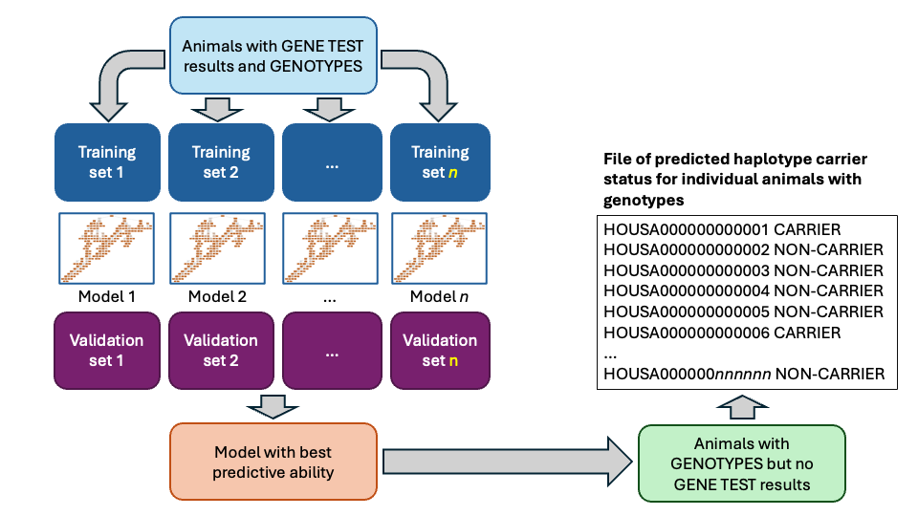

Slide 8
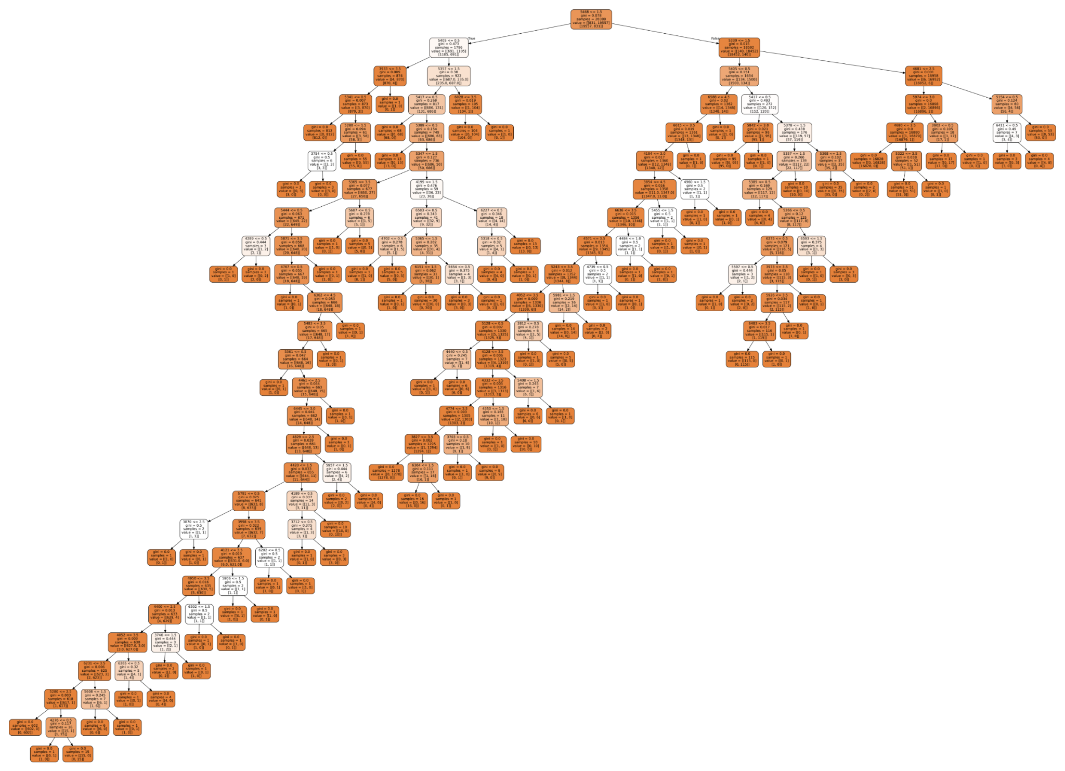
1
2
3
4

Slide 9
Brown Swiss Haplotype 6

Slide 10
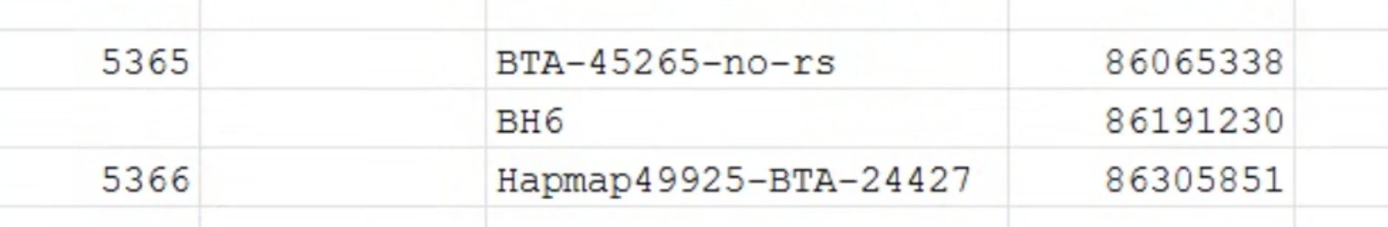
Brown Swiss Haplotype 6 (BH6)
Affected embryos die, causing fertility reductions.
The causal allele is located on chromosome 2.
It’s not in the SNP list, but we can still detect it via linkage disequilibrium because it falls in between 2 SNP we do track.
Causal variant (not included)

Slide 11
Concordance of BH6 calls from Hapcheck and HapchIQ with gene test results
Program | SNP list | Concordance
Hapcheck | Official | 46.5%
Hapcheck | Modified¹ | 92.2%
HapchIQ | Official | 90.7%
¹Addition of new DNA markers to the official SNP list requires that all genotypes be reimputed. This was done only for Brown Swiss animals for internal testing.

Slide 12
Run-to-run variation versus training set-to-training set variation
 |  |  |  |  | Changes in status
Training Set 1 | Evaluation Run 1 | Training Set 2 | Evaluation Run 2 | Number of animals | Non-carrier to carrier | Carrier to non-carrier
December 2024 | December 2024 | — | April 2025 | 82,553 | 3 | 0
December 2024 | April 2025 | — | August 2025 | 83,829 | 1 | 1
December 2024 | August 2025 | December 2025 | December 2025 | 90,062 | 78 | 46

Slide 13
Comparison of Hapcheck and HapchIQ results for BH6
 |  | HapchIQ (research)
 |  | Non-carrier | Carrier
Hapcheck (official) | Non-carrier | 87,932 | 32
 | Carrier | 51 | 4,656
 | Homozygous | 0 | 2

Slide 14
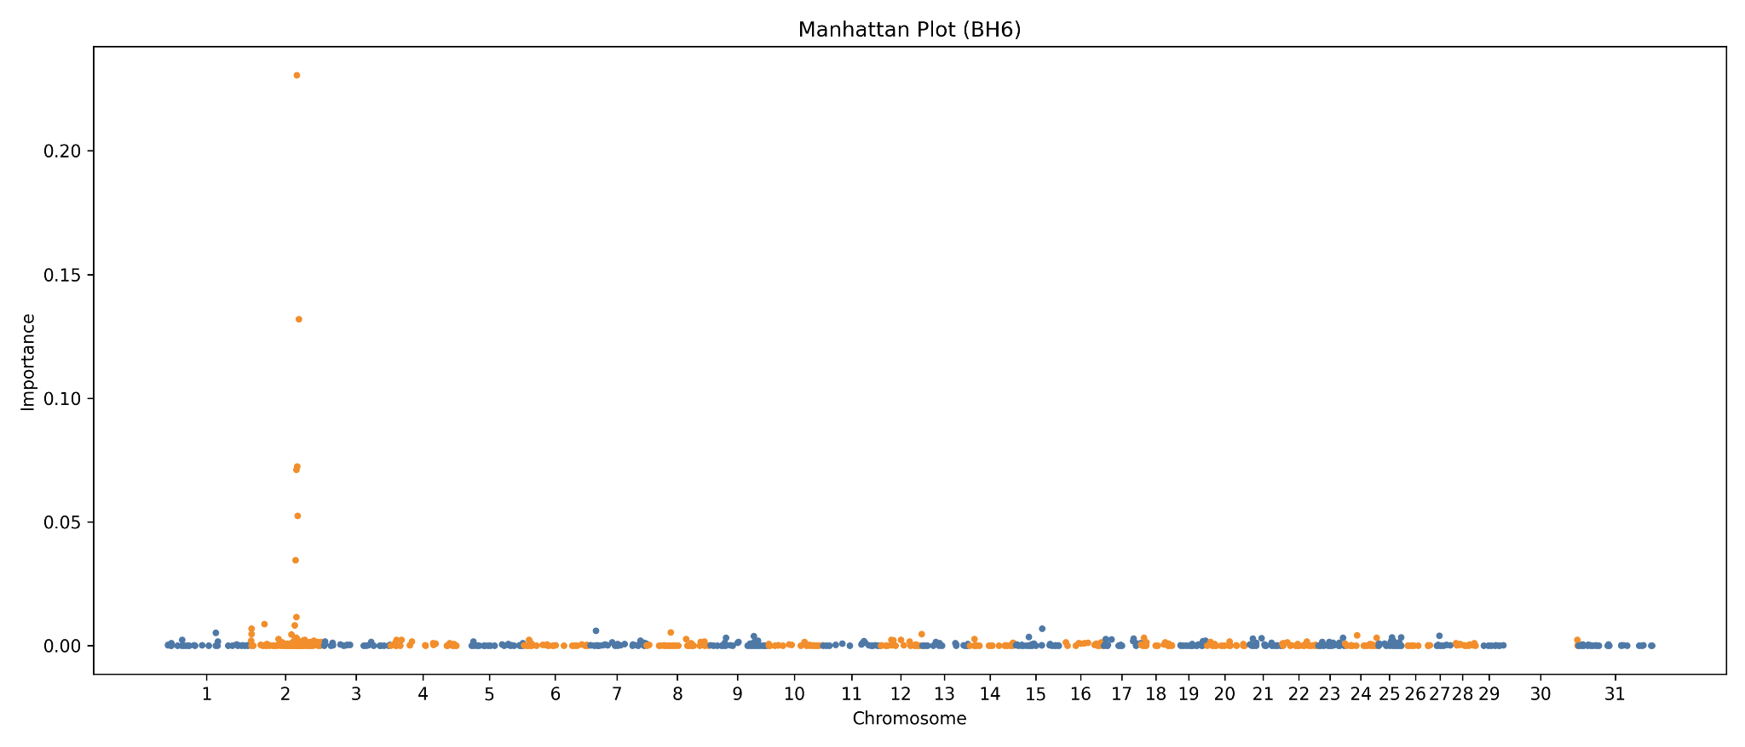

Slide 15
Brown Swiss, Holstein, and Jersey Polled

Slide 16
Challenges with polled calls
Multiple mutations produce polled animals.
Multiple than one variant is segregating in some breeds.
Many laboratory gene tests include only the Friesian mutation.
Hapcheck works well for Holstein but not for Brown Swiss and Jersey.
HapchIQ does much better with the current SNP list.
When additional polled SNP are added, the two methods are comparable.

Slide 17
Breed | SNP list | Program | Matches | Mismatches | Check | Concordance
BS | Official | Hapcheck | 17,679 | 3,047 | 20,726 | 85.3%
BS | Official | SNP | 16,531 | 2,949 | 19,480 | 84.9%
BS | Official | Hapchiq | 20,697 | 29 | 20,726 | 99.9%
BS | SNP name fix | Hapcheck | 20,661 | 65 | 20,726 | 99.7%
BS | SNP name fix | SNP | 20,721 | 5 | 20,726 | 100.0%
BS | SNP name fix | Hapchiq | 20,723 | 3 | 20,726 | 100.0%
JE | Official | Hapcheck | 17,559 | 9,928 | 27,487 | 63.9%
JE | Official | SNP | 17,643 | 9,671 | 27,314 | 64.6%
JE | Official | Hapchiq | 27,231 | 256 | 27,487 | 99.1%
JE | SNP name fix | Hapcheck | 26,784 | 671 | 27,455 | 97.6%
JE | SNP name fix | SNP | 27,452 | 33 | 27,485 | 99.9%
JE | SNP name fix | Hapchiq | 27,470 | 15 | 27,485 | 99.9%
HO | Official | Hapcheck | 55,943 | 2,714 | 58,657 | 95.4%
HO | Official | SNP | 55,929 | 2,667 | 58,596 | 95.4%
HO | Official | hapchiq | 58,248 | 409 | 58,657 | 99.3%
HO | SNP name fix | Hapcheck | 58,079 | 577 | 58,656 | 99.0%
HO | SNP name fix | SNP | 58,632 | 24 | 58,656 | 100.0%
HO | SNP name fix | Hapchiq | 58,590 | 66 | 58,656 | 99.9%

Slide 18
Other haplotypes

Slide 19
Comparison of Hapcheck and HapchIQ results for Holstein from August 2025
Haplotype | Mismatches | Genotypes | Concordance
Holstein Haplotype 1 | 1,233 | 9,088,709 | 99.99%
Holstein Haplotype 2 | 5,963 | 9,089,160 | 99.93%
Holstein Haplotype 5 | 2,170 | 9,088,709 | 99.98%
Holstein Cholesterol Deficiency | 44,410 | 8,914,901 | 99.50%
Holstein Muscle Weakness | 67,024 | 8,173,668 | 99.18%

Slide 20
Comparison of Hapcheck and HapchIQ results for other breeds from August 2025
Haplotype | Mismatches | Genotypes | Concordance
Ayrshire Haplotype 2 | 109 | 20,448 | 99.47%
Ayrshire Arthrogryposis Multiplex Congenita | 48 | 20,448 | 99.77%
Brown Swiss Weaver Syndrome | 101 | 90,081 | 99.89%
Brown Swiss Spinal Dysmyelination | 136 | 90,081 | 99.85%
Brown Swiss Haplotype 14 | 104 | 90,081 | 99.88%
Jersey Neuropathy with Splayed Forelimbs | 479 | 930,718 | 99.95%

Slide 21
Discussion and conclusions

Slide 22
Opportunities for improvement
Training is very sensitive to class imbalances
  2s for many haplotypes are infrequent relative to 0s and 1s, so the algorithm discards them as likely genotyping/imputation errors.
Training can be computationally intensive
  We limit input data to 1 or 2 chromosomes, but it’s not required.
  GPUs make a significant difference here but can be more expensive.
Research is underway to see if pedigree information can be incorporated into HapchIQ predictions
Nodes (rules) in the decision tree can be difficult to interpret

Slide 23
Opportunities for improvement (cont’d)
Data engineering is 80% of the work.
  Large flat-files of genotypes are hard to parse efficiently and within reasonable amounts of RAM.
Holstein Muscle Weakness is not performing as well
  HapchIQ may not work as well for haplotypes with incomplete penetrance.
  We’re exploring multi-chromosome inputs and hyperparameter tuning to explore this.

Slide 24
Conclusions
HapchIQ predictions of carrier status perform as well as Hapcheck in some cases, and better in others
A separate HapchIQ model is produced for each haplotype, and predictions can run in parallel
HapchIQ can provide a measure of certainty with each prediction, eliminating the need for “3” and “4” calls
CDCB will distribute test files beginning in August, with a goal of implementation for BH6 and POLLED in December 2026.

Slide 25
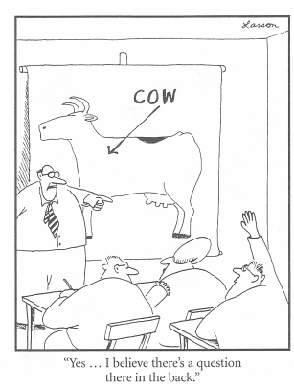
Questions?
Thank you for your
attention!
john.cole@uscdcb.com

